Slide 1

Music Generation Model Training and Evaluation
Introduction
This project aims to explore the capabilities of Transformer-based neural networks for generating music. By processing a large dataset of MIDI files, tokenizing musical events, and training a Transformer model, the project demonstrates how advanced sequence modeling techniques can be applied to create original music compositions.

Slide 2
Dataset
Source:
Preprocessing:
MIDI files were parsed to extract musical events, such as NOTE_ON, NOTE_OFF, pitch, and velocity. These events were converted into tokenized sequences for training.
The dataset consists of MIDI files from the specified directory
Processed Data:
Total files processed: 50
Sequences prepared: 620,734
Vocabulary size: 307 unique tokens

Slide 3
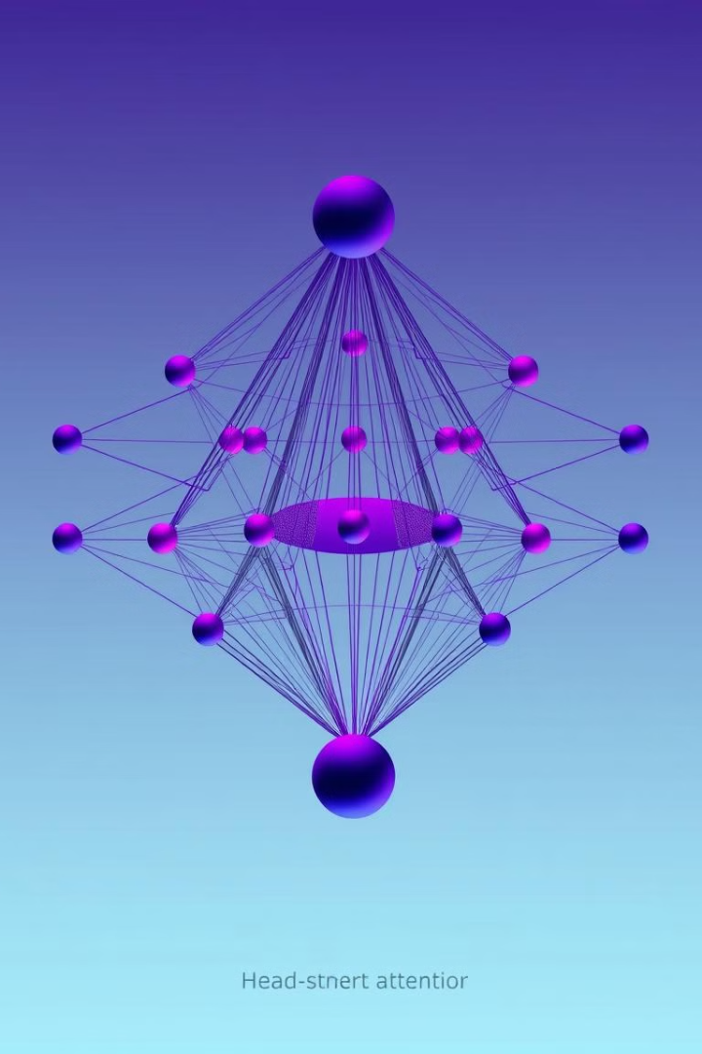
Model Architecture
Model Architecture
Base Model: Transformer architecture.
Key Features:
Embedding Size: 256
Number of Transformer Layers: 4
Number of Attention Heads: 8
Positional Encoding: A custom implementation of positional encoding was used to represent the temporal nature of the tokenized music sequences.
Model Summary:
Trainable Parameters: 15,869,747
Total Parameters: 15,869,747
Non-trainable Parameters: 0

Slide 4
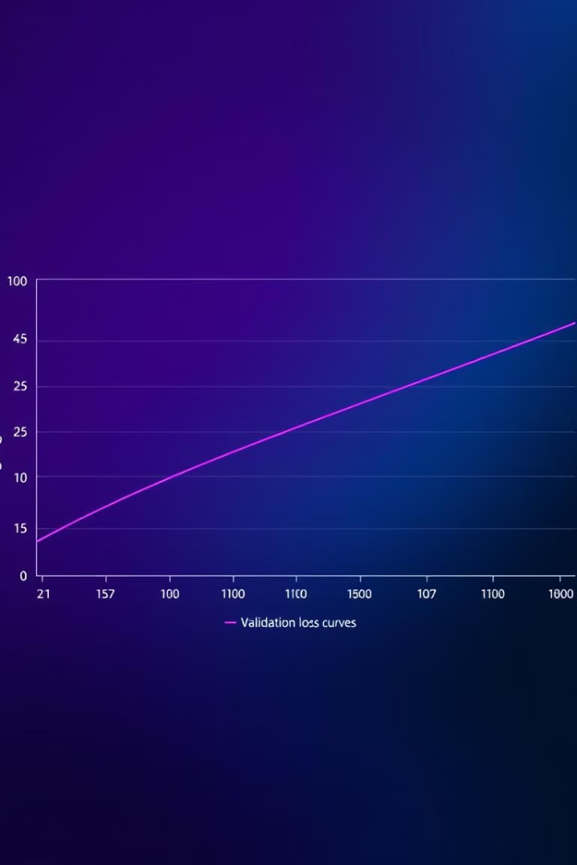
Training Performance
Input-Output Preparation:
Input sequences were of length 100 tokens.
Corresponding target sequences were shifted by one token to predict the next note in the sequence.
1
Epochs
2
Training Loss
The model was trained for 10 epochs.
Training loss gradually decreased over the epochs, converging at approximately 5.1330.
3
Validation Loss
Validation loss fluctuated slightly but remained consistent around 5.17, suggesting the model generalized reasonably well without severe overfitting.

Slide 5
Music Generation
Approach:
Sequences were generated using a trained model with temperature scaling, top-k sampling, and exclusion of top predictions for diversity.
music sequences were converted into MIDI format.4
Parameters:
Sequence length: 200 notes.
Diversity controls: Exclusion of top predictions (top-N), temperature adjustment, and top-k filtering.
Output:
Generated diverse music pieces saved as MIDI files in the generated_music_diverse directory.

Slide 6

Generated Music
The trained model successfully generated 5 music files, saved as: generated_music/generated_music_1.mid, generated_music/generated_music_2.mid, generated_music/generated_music_3.mid, generated_music/generated_music_4.mid, generated_music/generated_music_5.mid.
These files represent the model's capability to generate music sequences based on the learned patterns from the dataset.

Slide 7
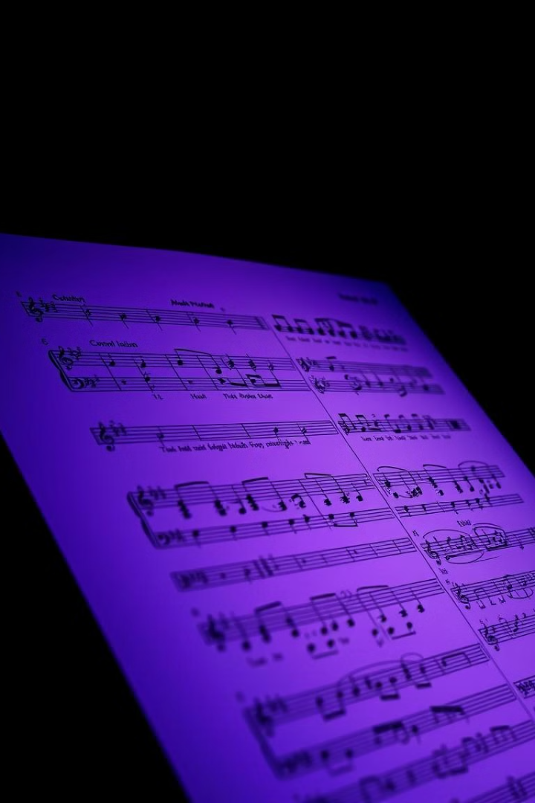
CHALLENGES AND OBSERVATION
Validation Loss:
The slight fluctuations in validation loss suggest overfitting or the need for further hyperparameter tuning.
Output Quality:
While the generated pieces show diversity, further fine-tuning of model parameters could enhance the quality and musicality of the compositions.
Data Size:
Processing only 50 MIDI files may limit the model's ability to generalize, highlighting the need for a larger dataset.

Slide 8

Recommendations and Future Work
Model Optimization
Evaluation Metrics
Experiment with a learning rate scheduler to further reduce fluctuations in validation loss. Use a larger dataset for improved generalization and reduced overfitting.
Introduce additional metrics such as accuracy or perplexity to better understand model performance.

Slide 9
Recommendations and Future Work
Larger Dataset:
Advanced Techniques:
Incorporate a more extensive collection of MIDI files to improve generalization.
Experiment with pre-trained Transformer models or techniques like transfer learning.
Real-Time Music Playback:
Integrate real-time playback functionality to evaluate generated sequences interactively.
Fine-Tuning:
Explore additional tuning strategies such as learning rate schedules and regularization techniques.

Slide 10
Generated Music Analysis
Perform qualitative and quantitative evaluations of the generated music to assess its creativity and coherence.

Slide 11

Conclusion
The implemented Transformer-based model demonstrated its capability to learn from a dataset of MIDI sequences and generate new music compositions. While the results are promising, there is potential for further improvement through model tuning and expanded datasets.

